Slide 1

Cyber Security, The Digital Antidote Of Cyber Crime
Md. Shabir Khan Akash Md. Shohanoor Rahman
Roll No: 1603108 Roll No: 1603112
Department of Computer Science and Engineering
Rajshahi University of Engineering and Technology

Slide 2
Outline
¹
Objective
Introduction
Literature review
Methodology
Statistical Data
Result Analysis
Future work
Conclusion
References

Slide 3
Objective
¹
1. Clearing the basic concept of cybersecurity
4. Marking out the most frequent and malicious cybercrimes we witness
3. Clearing the basic concept of cybercrime
2. Looking around us and finding the example of cybersecurity as a form of both physical and digital
5. Collecting some statistical data and survey of some various cyber attacks and analyze , compare them along with current cybersecurity backup system

Slide 4
Objective
¹
1. Clearing the basic concept of cybersecurity
4. Marking out the most frequent and malicious cybercrimes we witness
3. Clearing the basic concept of cybercrime
2. Looking around us and finding the example of cybersecurity as a form of both physical and digital
5. Collecting some statistical data and survey of some various cyber attacks and analyze , compare them along with current cybersecurity backup system

Slide 5
Objective
¹
1. Clearing the basic concept of cybersecurity
4. Marking out the most frequent and malicious cybercrimes we witness
3. Clearing the basic concept of cybercrime
2. Looking around us and finding the example of cybersecurity as a form of both physical and digital
5. Collecting some statistical data and survey of some various cyber attacks and analyze , compare them along with current cybersecurity backup system

Slide 6
Objective
¹
1. Clearing the basic concept of cybersecurity
4. Marking out the most frequent and malicious cybercrimes we witness
3. Clearing the basic concept of cybercrime
2. Looking around us and finding the example of cybersecurity as a form of both physical and digital
5. Collecting some statistical data and survey of some various cyber attacks and analyze , compare them along with current cybersecurity backup system

Slide 7
Objective
¹
1. Clearing the basic concept of cybersecurity
4. Marking out the most frequent and malicious cybercrimes we witness
3. Clearing the basic concept of cybercrime
2. Looking around us and finding the example of cybersecurity as a form of both physical and digital
5. Collecting some statistical data and survey of some various cyber attacks and analyze , compare them along with current cybersecurity backup system
Md. Shabir Khan Akash, Md. Shohanoor Rahman (RUET)
25-Sep-19

Slide 8
Introduction
Basic forms of Cybersecurity
Physical Forms of Cybersecurity
Digital Forms of Cybersecurity

Slide 9
Introduction
Physical Forms of Cybersecurity
Door access and IP Cameras
High Security Sensor Vault

Slide 10
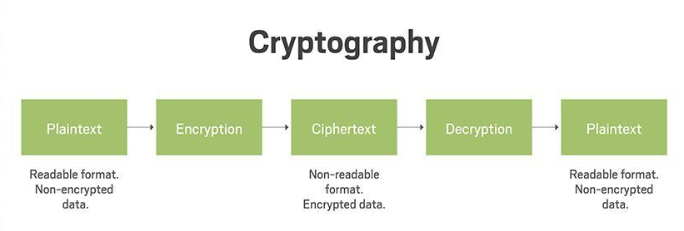



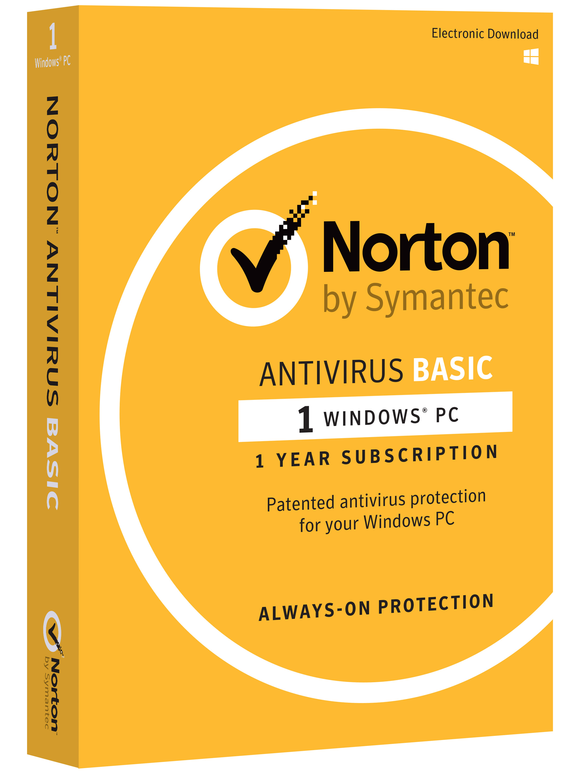
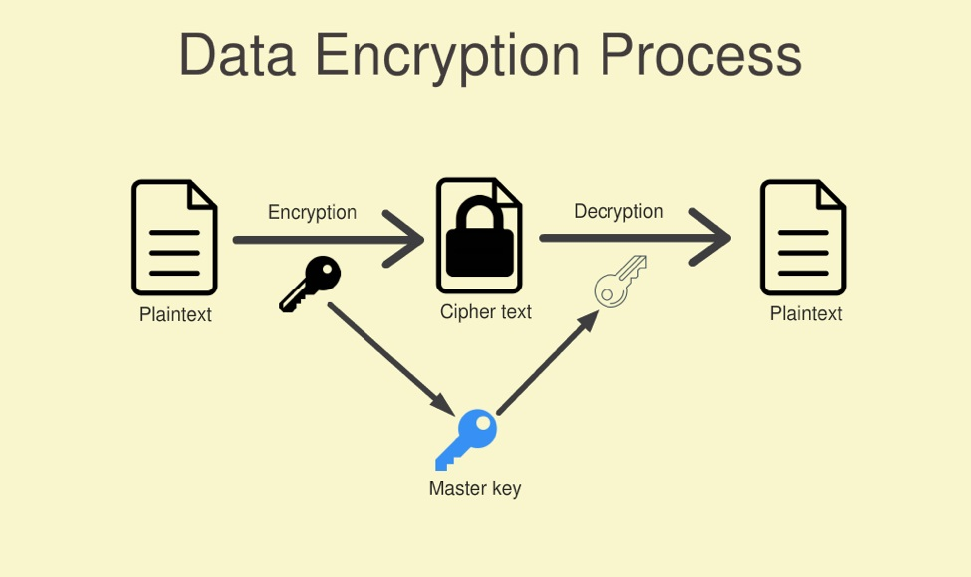
Introduction
Digital Forms of Cybersecurity
Anti-virus Softwares

Slide 11
Introduction
Cybercrime, or computer-oriented crime, is a crime that involves a computer and a network.
Financial fraud crimes
Cyberterrorism
Online harassment/ Cyberbully
Online Drug Dealing
Unethical Hacking
Scamming, Spamming etc.

Slide 12
Literature Review
Literature Review
Every message sent from source A to source B reaches the attacker before reaching its
destination.
A DoS or DDoS attack is analogous to a group of people crowding the entry door of a shop, making it hard for legitimate customers to enter, thus disrupting trade.
Criminal perpetrators of DoS attacks often target sites or services hosted on high-profile web servers such as banks or credit card payment gateways
Social engineering is the general term that describes techniques used to gain unauthorized access to information through human interaction.

Slide 13
Methodology
For ensuring the improved cyber secured internet surfing some steps may be taken :
MOVING AWAY FROM USING UNSUPPORTED SOFTWARE
MANAGING SECURITY RELATIONSHIPS WITH SUPPLIERS AND PARTNERS
BACKING UP OWN DATA
USING STRONG PASSWORDS
RUNNING UP-TO-DATE ANTI-VIRUS SOFTWARE
DELETEING SUSPICIOUS EMAILS AND AVOID CLICKING ON UNKNOWN ATTACHMENTS OR LINKS
ALWAYS DOWNLOADING AND INSTALLING THE LATEST SOFTWARE AND APP UPDATES

Slide 14
Statistical Data
Statistical Data on Various Cyber Crimes ( Phishing Domain )
According to the Global Phishing Survey: Trends and Domain Name Used in 2016 appeared
in APWG Unifying the Global Response To Cybercrime :
Table 1: Basic statistical data table on Phishing Attacks and Domains(2013-2016) (Greg and R. Rod, 2017)
 | 2013 | 2014 | 2015 | 2016
Phishing Domain | 135,848 | 183,222 | 160,155 | 195,475
Attacks | 188,323 | 247,713 | 227,471 | 255,065
TLDs | 223 | 288 | 355 | 454
new gTLDs | 0 | 72 | 120 | 228
IP-based phish | 4,366 | 6,472 | 2,245 | 5,378
Harmful Domains | 35,004 | 49,932 | 34,102 | 95,424

Slide 15
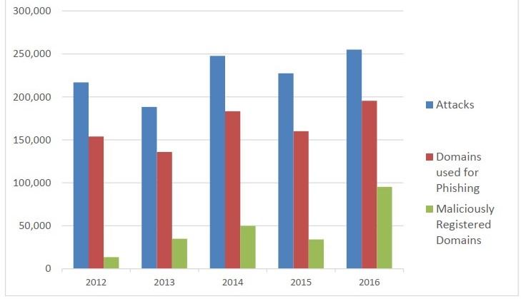
Statistical Data
Bar chart on Domain Attack
Figure: Phishing Attacks and Domains Used (2012-2016) (Greg and R. Rod, 2017)

Slide 16
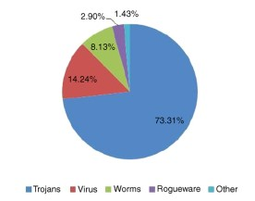
Statistical Data
Pie chart on some well known types of malware
According to the book named “Computer security: Protecting digital resources” authored by
Robert C. Newman in 2009 , there was a survey of the types of malware
Figure: Types of malware (R. C. Newman, 2009)

Slide 17
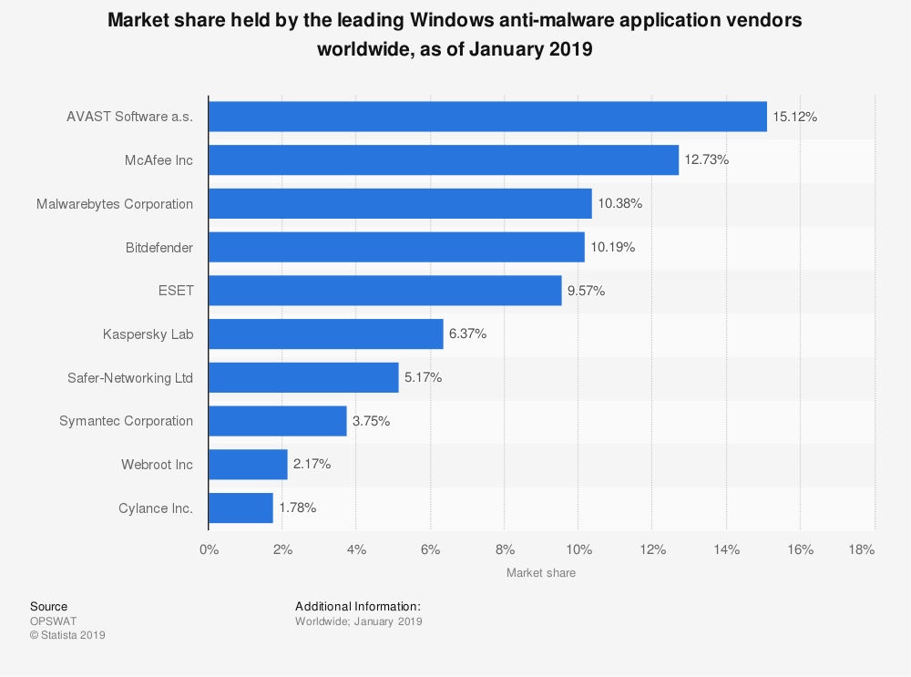
Statistical Data
Survey on market share held by Antivirus companies
According to the survey of OPSWAT IT company from their Statista 2019 bulletin, market share
Held by some leading anti-malware application companies can be observed below
Figure: Survey on market share held by Antivirus companies till January 2019 (OPSWAT, 2019)

Slide 18
Result Analysis
Final Result Analysis
So based on the analysis of the above statistical data on both cybercrime and cybersecurity, it can be said in the end that,
cyber crimes are emerging at a high rate of growth which is a very threatening situation. Though nowadays cybersecurity systems are advancing way to quickly to the betterment of cyberspace
Though it is a matter of regret that still some third world countries' people aren't aware of these cybercrimes even it is as much sensitive as any other crimes around us. A proper cautious mind and ability to make the right and efficient decision can fetch the secure internet experience.
Thus these discussed cybersecurity around us, being the antidote of those malicious cybercrimes with the aim of ensuring a safe and secure internet experience to all the users,

Slide 19
Future Works
Future Works on the aspect of Cybercrime and security
Though cybersecurity is upgrading itself quite in a good pace, there needs to be done some future research or upgrading works to ensure much safety and secure environment.
Ensuring a safer internet for upcoming generation
Increasing the development of trustworthy software
Developing Security System

Slide 20
Conclusion
Conclusion
This rise in the widespread use of technology brought with it a rise in cybercrime. For hackers, the possibilities increased exponentially, along with the potential rewards.
The fact that cybercrime now permeates every facet of society shows why cyber security is crucially important.
Cybersecurity systems are advancing way to quickly to the betterment of cyberspace and with the aim of ensuring a safe and secure internet experience to all the users.
Minimum cyber security requirements for a network should be Endpoint Protection, Firewall, Intrusion Detection System / Intrusion Prevention System, Web Filtering Software, Radius Server, Logging Softwares, Encryption. Despite new effort for secure cyberspace, more research is needed to develop new security options that will treat the most resistant strains of cybercrime.

Slide 21
References
Garnaeva, Maria, Fedor Sinitsyn, Yury Namestnikov, Denis Makrushin, and Alexander Liskin. 2016.
“Kaspersky Security Bulletin OVERALL STATISTICS FOR 2016.” Kaspersky Security Bulletin: 12–13.
Greg, Aaron, and Rasmussen Rod. 2017.
“Global Phishing Survey: Trends and Domain Name Use in 2016.
” APWG Unifying the Global Response To Cybercrime: 6–17.
Jang-Jaccard and S. Nepal, 2014.
“A survey of emerging threats in cybersecurity,” Journal of Computer and System Sciences, pp. 973–993.
Newman, Robert C. 2009.
Computer security: Protecting digital resources.
Jones & Bartlett Publishers.
OPSWAT, 2019. “Statista 2019”.

